Slide 1
BlinkIt Grocery Sales Analysis
Presented By:
Mohammed Uvez K

Slide 2
Introduction
Blinkit, formerly known as Grofers, is one of India’s leading instant grocery delivery platforms, offering a wide range of products delivered to customers within minutes. With the growing reliance on quick commerce, Blinkit operates in a competitive and fast-paced environment where data analytics plays a crucial role in maintaining operational efficiency, enhancing customer satisfaction, and driving growth.

Slide 3
Objectives
Analyze sales trends to identify the best-selling and least popular grocery items.
Determine peak demand periods and assess regional sales performance for optimized operations.
Utilize customer feedback and sales data to enhance product offerings and customer satisfaction.
Integrate database connectivity for real-time data analysis and dynamic reporting.
Provide actionable insights to improve operational efficiency and drive business growth.

Slide 4
About the Dataset
Source: The dataset will be sourced from Kaggle.
Features: Key features include Order ID, Product names, Sales quantity, Timestamps, Regions and Customer feedback.
Purpose:
Identify the best-selling and least popular grocery items.
Analyze time-series data to predict customer demand and optimize inventory.
Enhance service efficiency through data-driven decision-making.

Slide 5
METHODOLOGY
Data Collection: The dataset will be sourced from Kaggle.
Database Connectivity: Establish a connection to the Blinkit database using tools like MySQL for real-time data querying.
Exploratory Data Analysis (EDA): Handle missing data using imputation techniques, Summarize the dataset using descriptive statistics and Create visualizations (e.g., histograms, box plots, and correlation heatmaps) to understand sales trends, feature distributions, and interactions.
Visualization: Generate visual representations (e.g., dashboards, bar charts, and line graphs) to highlight findings and support decision-making.
Reporting: Compile analysis, results, and actionable insights into a detailed report.

Slide 6
TOOLS AND TECHNOLOGIES
Programming Language: Python.
Libraries: Pandas, NumPy, Matplotlib, Seaborn and mysql.connector.
Database: PostgreSQL/MySQL for backend data storage.
IDE: Jupyter Notebook or any Python-compatible IDE.

Slide 7
EXPLORATORY DATA ANALYSIS (EDA)
Importing Libraries: Import essential libraries for data manipulation and visualization.
Loading Dataset: Establish a connection to the database and load the data into a Pandas DataFrame.
Basic Exploration : Perform an initial examination of the dataset to understand its structure.
Checking Missing Values: Identify missing values in the dataset.
Descriptive Statistics: Summarize the dataset to understand the central tendency and spread of the data.
Identifying Duplicates: Check for duplicate rows in the dataset.
Data Visualization: Use visualizations to gain more insights into the data.

Slide 8
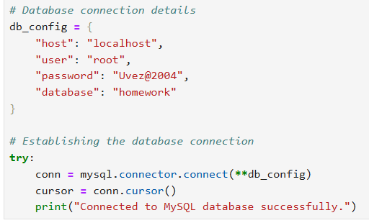
Database Connectivity
Step-by-Step Process:
Database Setup:
Configure PostgreSQL/MySQL with schema matching the dataset.
Python Integration:
Use MySQL for connectivity.
Code Snippet:

Slide 9
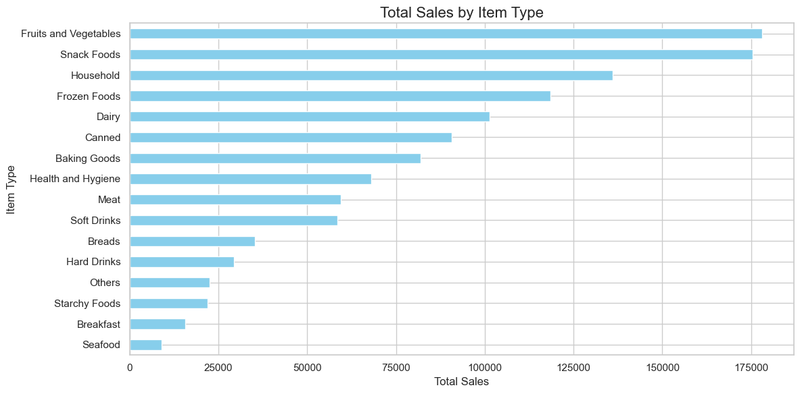
ANALYSIS QUESTIONS
Total sales by Item Type

Slide 10
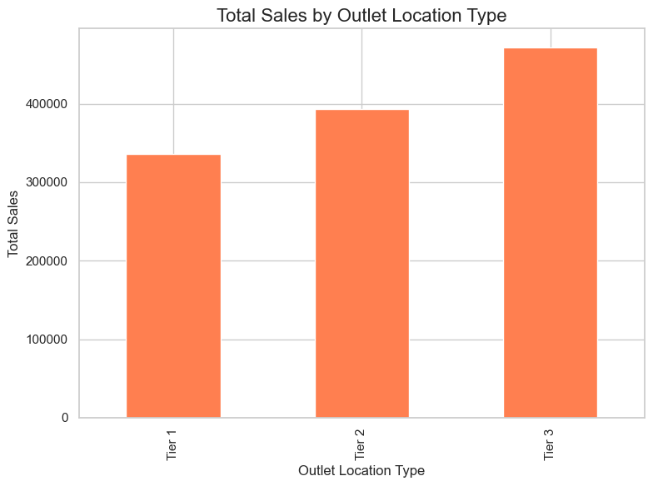
Total sales by Outlet Location Type

Slide 11
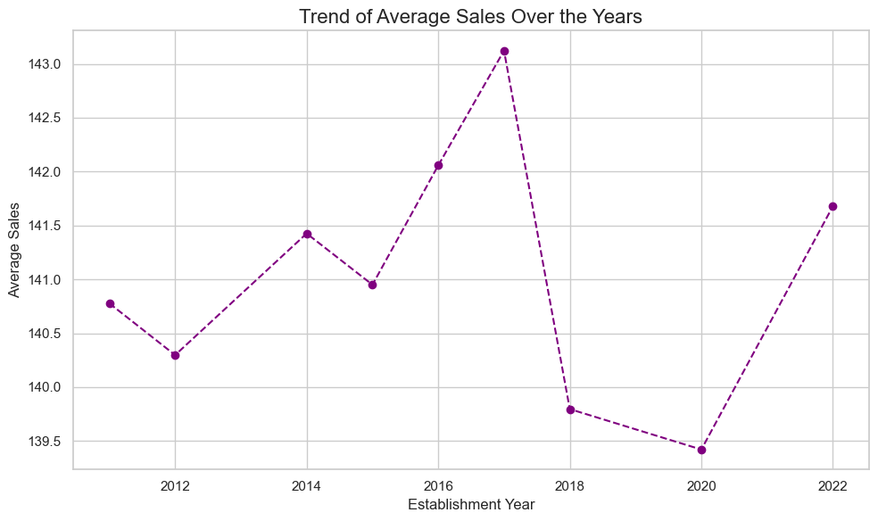
Trend of average sales over the years

Slide 12
Conclusion
The Blinkit grocery sales analysis provides valuable insights into consumer behavior, inventory needs, and operational improvements. It enables data-driven strategies for enhanced customer satisfaction and business efficiency.

Slide 13
THANK YOU!

